Slide 1


Network Adequacy
Data Maintenance Planning
10:00 am-11:15 am Central
August 18, 2025
Regulatory Health Link Division,
Arkansas Insurance Dept., Dept. of Commerce

Slide 2
Agenda
Introductions & housekeeping.
Recap of some areas.
Timeline Overview.
Upcoming PTNP Changes
Questions.

Slide 3
Agenda
Introductions & housekeeping.
Recap of some areas.
Timeline Overview.
Upcoming PTNP Changes
Questions.

Slide 4
Recap – NA Standards
With the decision to have only one NA standard in the state, preferably a national standard, the CMS-CCIIO NA standards which was mandatory in the marketplace was chosen as the state’s NA standard starting PY2026.
Rule 106 amendment is in the draft stages as kinks in the implementation are being worked on (For example: Time allowances for different processes).
A new process was introduced to improve provider address quality targeting addresses that, if incorrect, were more likely to make competitors look inadequate: the Isolated Outlier Review Process.
Network shortcomings were compared against an “ideal network. The ideal network was built aggregating issuer provider locations reported by all issuers in the plan year. These providers had to exist in the PTNP. Shortcomings were communicated as objections only when the ideal network indicated that improvement was possible.
Network shortcomings were communicated using a customized justification template, enriched with an interactive visualization that made the data leading to the objection more accessible, such as the OON provider locations plotted over a deficiency county map for a provider type. Access to additional data and design of the template has avoided a lot of the confusion of the past and allowed for more pertinent and pointed dialog.
AID would welcome feedback on the overall implementation on anything the Department may have got wrong, or anything that we need to keep doing. The Department intends to have one-on-one meetings after it completes its study of the Justification template responses.

Slide 5
Recap – Provider Classification
With CCIIO NA standards came CCIIO provider type definitions. States were allowed to be stricter in their definitions, not the other way round.
We kept our industry-collaborative data governance process going but operating with entirely new data- the new data being PTNP buckets with CCIIO provider type definitions.
PY2026 CCIIO provider type definitions has been used to guide Arkansas PY2027 provider type definitions (published as Provider Type Taxonomic Descriptions). CCIIO provider type definition changes announced with short notices cannot be accommodated in the PTNP process.
AID reminds issuers that provider taxonomic definitions are a guideline of provider practice that is acceptable within the provider type. Arkansas has a consumer-oriented perspective towards provider-type definitions. What the provider actually practices is most important – and not everything the provider’s qualification allows to be practiced.
AID “seeded” the new PTNP buckets using issuer self-reported classifications from the PY2025 NA templates. Not all problem classifications were corrected in the PTNP round that followed.
In the Justification template, some justifications under the umbrella “Provider locations reported by others is incorrect” appeared more a classification related issue than a location problem. It is very important clean-up of the PTNP based on such justifications. Cleaning up classifications misreported by others is not “others” responsibility but yours when you have got an objection because of it.

Slide 6
Recap: Provider Address correction opportunities
The Isolated Outlier Review process was introduced for manageable and targeted address corrections. The process generated a high yield of address corrections based on feedback from some issuers.
Isolated outlier addresses are not necessarily inaccurate but have a high likelihood of creating problems for others.
The timeline allowed for address correction at source systems was too tight
The responses in the customized justification template has generated another source of potentially incorrect address pointers– with issuers objecting to some OON provider locations. These contested outlier locations would be sent to each issuer furnishing these locations for scrutiny and corrections.
AID will keep a track of the contested location addresses and their counts, both for the issuer contesting locations and the issuer being informed of the contest.

Slide 7
Recap: Two important deadlines
Two new processes/or concepts introduced in PY2026, needs data from *all* issuers together to proceed, irrespective of segment : individual, small or large group. Please pay attention to meeting the deadlines to these processes the when submission of your NA templates is due.
The Isolation Outlier process
The “Ideal Network” development at the start of the Network Review for certification (with data submissions in SERFF)

Slide 8
Agenda
Introductions & housekeeping.
Recap of some areas.
Timeline Overview.
Upcoming PTNP Changes
Questions.

Slide 9
Artifacts published Aug 18, 2025
NA Review Process (PDF)
Network Adequacy Industry Contact List (PDF)
2025 Round 2 Initial Provider Type-NPI Pool Template (Excel)
Provider Type Taxonomic Descriptions (Excel)

Slide 10
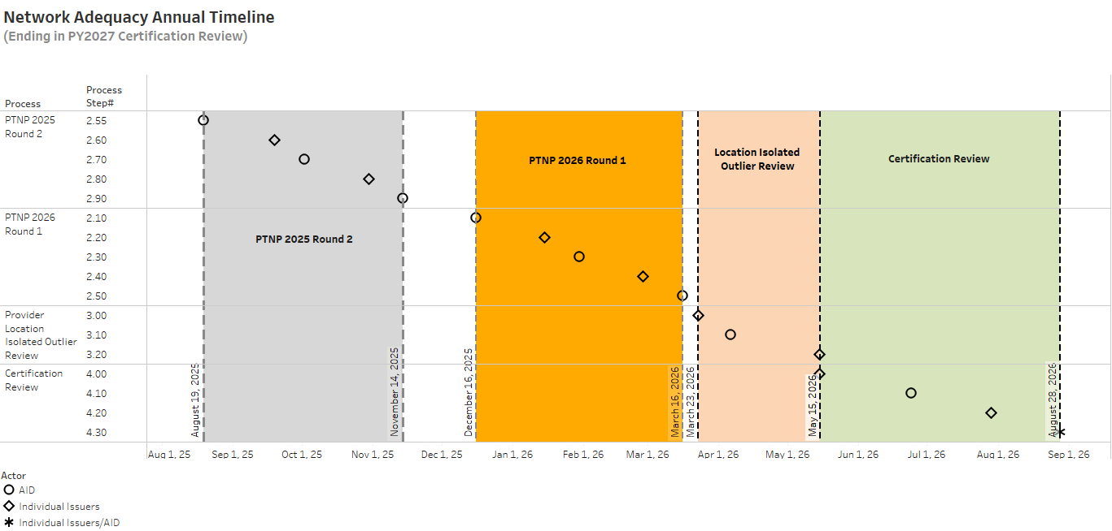
NA Review Process
We are here

Slide 11
Isolated Outlier review for PY2027
The same template submitted nearly two months apart
Issuers prepare prelim NA Template
7 days
AID generates outlier reports
14 days
Issuer to review and correct outliers as needed
15 39 days
3/16/2026
Finalized PTNP (Round 1 of 2026)
4/6/2026
Isolated Outlier reports to issuers by AID
Mid-May (tentative) Submit CMS PY2027 NA template in SERFF for review
3/23/2026
Submit NA template using CMS PY2026 template
Likely different versions of CMS NA template delivered outside SERFF (3/23) and inside SERFF (~5/15)

Slide 12
PTNP Round 2 of 2025
Issuers & AID meet
Stage 1 (Issuers suggesting changes)
31 days
13 days
Stage 2 (Issuers voting)
28 days
15 days
8/19/2025-Initial template published
9/19/2025
Add/Delete Suggestions from Issuer
10/2/2025
Consolidated suggestions by AID
10/30/2025 Votes from Issuers
11/14/2025
Finalized PTNP by AID

Slide 13
Agenda
Introductions & housekeeping.
Recap of some areas.
Timeline Overview.
Upcoming PTNP Changes
Questions.

Slide 14
PTNP Changes
Changes to the PTNP data and processes for 2025 round 2

Slide 15
PTNP Changes Summary
NOW
Adoption of CMS GACH list for F001: Acute Inpatient Hospital
Addition (restoration) of Pharmacies as criteria A280: Pharmacy
Removal of Internal Medicine as suggested qualifier for P038: Primary Care – Adult
LATER
Suggested removal of seeding reliant on Internal Medicine
Suggested removal of seeding reliant on single classification in opposition to others

Slide 16
PTNP Changes Details Adoption of CMS GACH list for F001: Acute Inpatient Hospital
CMS is maintaining the list of qualified General Acute Care Hospitals nationwide
Final update for PY2026 was August 1
Hospitals within maximum distance (100 miles) of AR are included
We are still including NPIs in the PTNP, but no PTNP additions or removals will be accepted for F001
Removed NPIs are in a one-time informational tab in the Initial List Template
Most are an update to the available NPI
Those that are not do not meet CMS requirements

Slide 17
PTNP Changes Details Addition (restoration) of Pharmacies as criteria A280: Pharmacy
Objective is to identify and maintain list of Community Retail Pharmacies
Initial seeding was a combination of NPPES NPI Registry and NCPDP identifiers, favoring Retail Pharmacy as the primary taxonomy and Retail Pharmacy as the primary NCPDP classification
We know that there are errors; please pay close attention to Pharmacies in the PTNP, but remember to focus on Community Retail Pharmacies only

Slide 18
PTNP Changes Details Removal of Internal Medicine for P038: Primary Care – Adult
Internal Medicine is a broad qualifier, usually as a precursor to a targeted specialty
Taxonomy is intended only as a clue anyway
Focus should be on care role given to patients not on taxonomy or CMS specialty

Slide 19
PTNP Changes Details (LATER) Suggested removal of seeding reliant on Internal Medicine
Per CMS taxonomy mapping, we included Internal Medicine as a Primary Care – Adult qualifier
As stated above, AID believes this is overly broad
During the Add / Delete phase of 2025 Round 2, we will suggest for removal:
NPIs that were included as PCP solely because of Internal Medicine, and
That were not previously classified as a PCP

Slide 20
PTNP Changes Details (LATER) Suggested removal of seeding reliant on single classification in opposition to others
During initial seeding, AID
Erred on the side of inclusion
Made no judgements on disagreements
Trusted industry participation to correct erroneous inclusions
To correct, AID will recommend removal where
Only a single company group recommended inclusion, and
Two or more other company groups included in an opposing criteria
In the case of a tie (1 vs. 1), AID will make a research-based judgement

Slide 21


Discussions & Questions
Email
RHLD.DataOversight@arkansas.gov

